Slide 1


STRATEGIC CONTENT INSIGHTS FOR NETFLIX
-------------------------------------------------------------------------------------
BDM CAPSTONE PROJECT
BY ARYAN THAKUR | 23F3001987 | IITM

Slide 2









PROJECT OVERVIEW
Content Analysis
1
To analyze Netflix’s content library (till 2021) and uncover key trends in type, genre, and maturity rating.
2
3
Regional Insights
GOAL
To study regional content distribution and identify underrepresented markets.
8807 ROWS
AND
12 FEATURES
4
5
6
DATA
Strategic Direction
7
To derive insights that support Netflix’s strategic content and expansion decisions.
8
The analysis revealed that Netflix’s content is dominated by movies and mature-rated titles, with strong contributions from the U.S. and India. The findings provided actionable insights for improving regional diversity and balancing content across different audience groups.

Slide 3







ABOUT NETFLIX
1
2
1
Global Expansion
Localization Strategy
4
Netflix operates in 190+ countries with a strong focus on international markets.
Produces regional content in local languages to appeal to diverse audiences.
3
4
2
Original Content
Subscription Model
5
5
NETFLIX
Relies on a B2C subscription-based revenue model with tiered pricing.
Heavy investment in Netflix Originals to differentiate from competitors
6
7
8
3
Data-Driven Decisions
Mature Content Focus
6
Uses viewer data to guide content creation and recommendations
Increasing emphasis on TV-MA and adult-oriented storytelling to attract global audiences.

Slide 4







OBJECTIVES
1
01
02
03
04
05
2
3
4
5
6
Content Exploration
Regional Analysis
Trend Identification
Audience Insights
Strategic Insight Generation
7
To analyze Netflix’s catalog based on type, genre, release year, and maturity rating to understand its overall structure.
To study country-wise content distribution and highlight regions that are underrepresented or oversaturated
To examine how content releases have evolved over time and identify shifts in Netflix’s production and acquisition strategy
To understand maturity rating patterns and how Netflix targets different audience groups across regions
To derive data-driven conclusions that can guide Netflix’s future content planning and global expansion efforts
8

Slide 5





METHODOLOGY
1
2
3
4
Data Collection
Data Cleaning
Feature Processing
Exploratory Analysis
Insight Extraction
5
The Netflix dataset (up to 2021) was sourced from a publicly available platform, ensuring reliability and consistency for analysis
Missing values in key fields like director, cast, and country were handled appropriately, and formats for dates and text fields were standardized for accuracy
Relevant columns such as type, listed_in, rating, and release_year were prepared, transformed, and organized to enable meaningful analysis
Visualizations and summary statistics were used to uncover trends in content type, release patterns, maturity ratings, and regional contributions
Patterns observed from graphs and statistics were interpreted to identify strategic opportunities for Netflix’s content and regional expansion
6
7
8
01
02
03
04
05

Slide 6
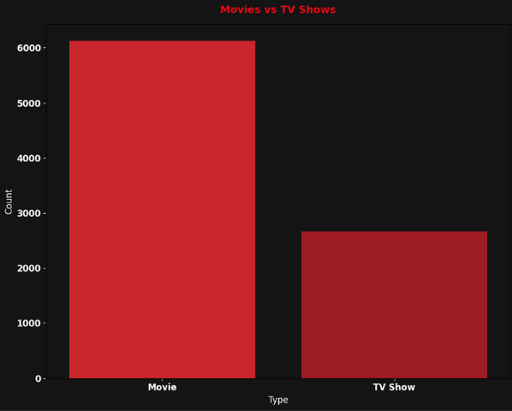
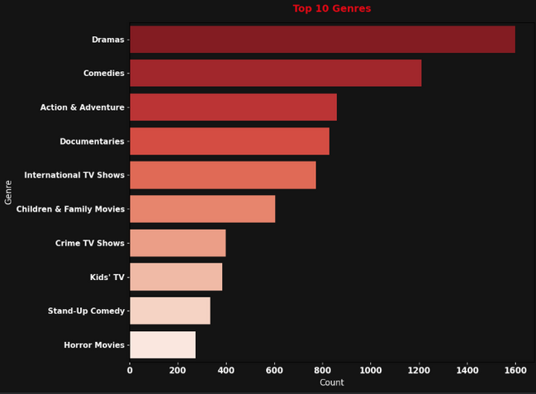
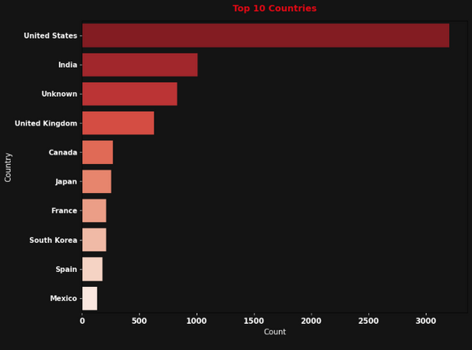
CONTENT DISTRIBUTION AND GLOBAL PATTERNS
1
2
3
4
5
Movies vs TV Shows on Netflix
Top 10 Most Common Genres on Netflix
Top 10 Countries by Number of Titles
6
This chart shows that movies make up most of Netflix’s catalog, reflecting the platform’s earlier focus on film-based content. However, TV shows have grown noticeably in recent years, mainly due to the success of Netflix Originals and the demand for long-form storytelling. This shift highlights Netflix’s evolving strategy to keep viewers engaged for longer periods.
The genre distribution shows that Drama, Comedy, and Documentaries dominate the platform, suggesting that Netflix prioritizes emotionally engaging and globally relatable storytelling. The strong presence of international genres also indicates Netflix’s effort to cater to a wide audience base across different regions and cultural preferences.
The U.S. leads by a large margin in total content, followed by India and the U.K., showing Netflix’s strong dependence on major production hubs. This uneven distribution highlights how certain countries are highly represented while others remain underserved. These insights point toward potential expansion opportunities in underrepresented regions to build a more globally diverse catalog.
7
8

Slide 7
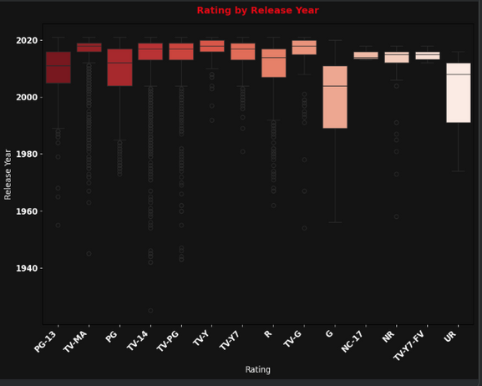
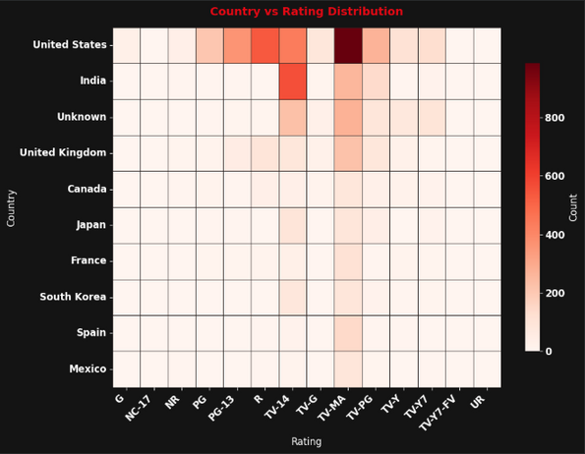
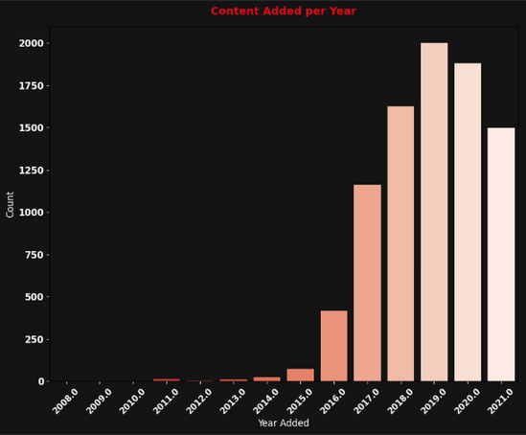
DEEPER CONTENT & AUDIENCE TRENDS
1
2
3
4
5
6
Rating by Release Year
Release Year Trend
Rating Distribution by Top Countries
This boxplot shows how maturity ratings have evolved over time. Earlier titles were mostly rated PG, TV-PG, or TV-14, indicating a family-oriented focus in older releases. However, after 2015, there is a clear rise in TV-MA and R-rated titles, reflecting Netflix’s shift toward more mature content. This trend suggests the platform’s growing emphasis on adult audiences and complex, high-engagement storytelling.
The release-year trend demonstrates a major increase in Netflix content production after 2015, coinciding with the company’s global expansion and heavy investment in Netflix Originals. The rapid growth indicates how Netflix moved from being primarily a content distributor to becoming one of the largest producers of digital entertainment. This pattern also highlights the competitive push to continuously add fresh, appealing content.
This visualization highlights how maturity ratings differ between major content-producing countries. The U.S. and India contribute a significant amount of TV-MA content, reinforcing Netflix’s strong adult-oriented offerings from these regions. In contrast, countries like Japan and South Korea lean more toward PG-13 or TV-14 categories. These variations reveal how cultural norms, audience expectations, and certification standards shape the type of content Netflix acquires or produces in each region.
7
8

Slide 8








KEY PROBLEMS AND INSIGHTS
1
01
07
02
03
05
06
04
2
3
4
5
Uneven Country Contribution
Genre Saturation
Release Year Concentration
Inconsistent Rating Trends Across Regions
6
Maturity Rating Skew
Regional Imbalance
Lack of Family Content
Smaller countries contribute very few titles, limiting cultural diversity in the catalog
Drama, Comedy, and Documentaries dominate, while several genres remain underserved
Majority of titles were released after 2015, indicating a strong recency bias
7
Most recent titles are TV-MA, showing an imbalance toward mature content
Content is heavily concentrated in a few countries like the U.S. and India, with many regions underrepresented
PG and TV-PG categories are limited, reducing appeal for younger viewers and families
Some countries focus heavily on mature ratings, while others lean more toward PG-13/TV-14, showing inconsistent global content balance
8

Slide 9


RECOMMENDATIONS & CONCLUSION
1
Expand Regional Diversity
Balance Maturity Ratings
2
01
02
3
Increase content from underrepresented countries to improve cultural balance
Add more PG and family-friendly content to attract younger audiences
4
5
6
7
Broaden Genre Mix
Strengthen Local Productions
8
Invest in less-represented genres to reach niche viewer groups and expand audience interest
03
04
Collaborate with regional creators to build country-specific originals and boost global presence.

Slide 10
THANK YOU

